Slide 1
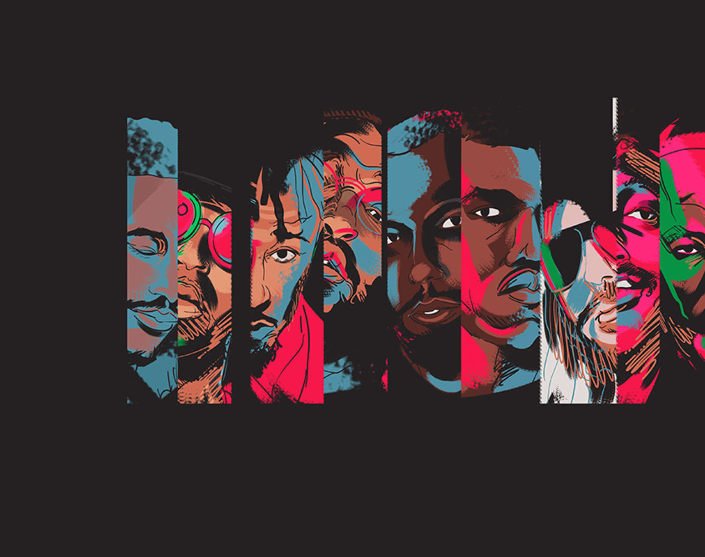
Evolution of Rap Music
Feb. 28, 2020

Slide 2
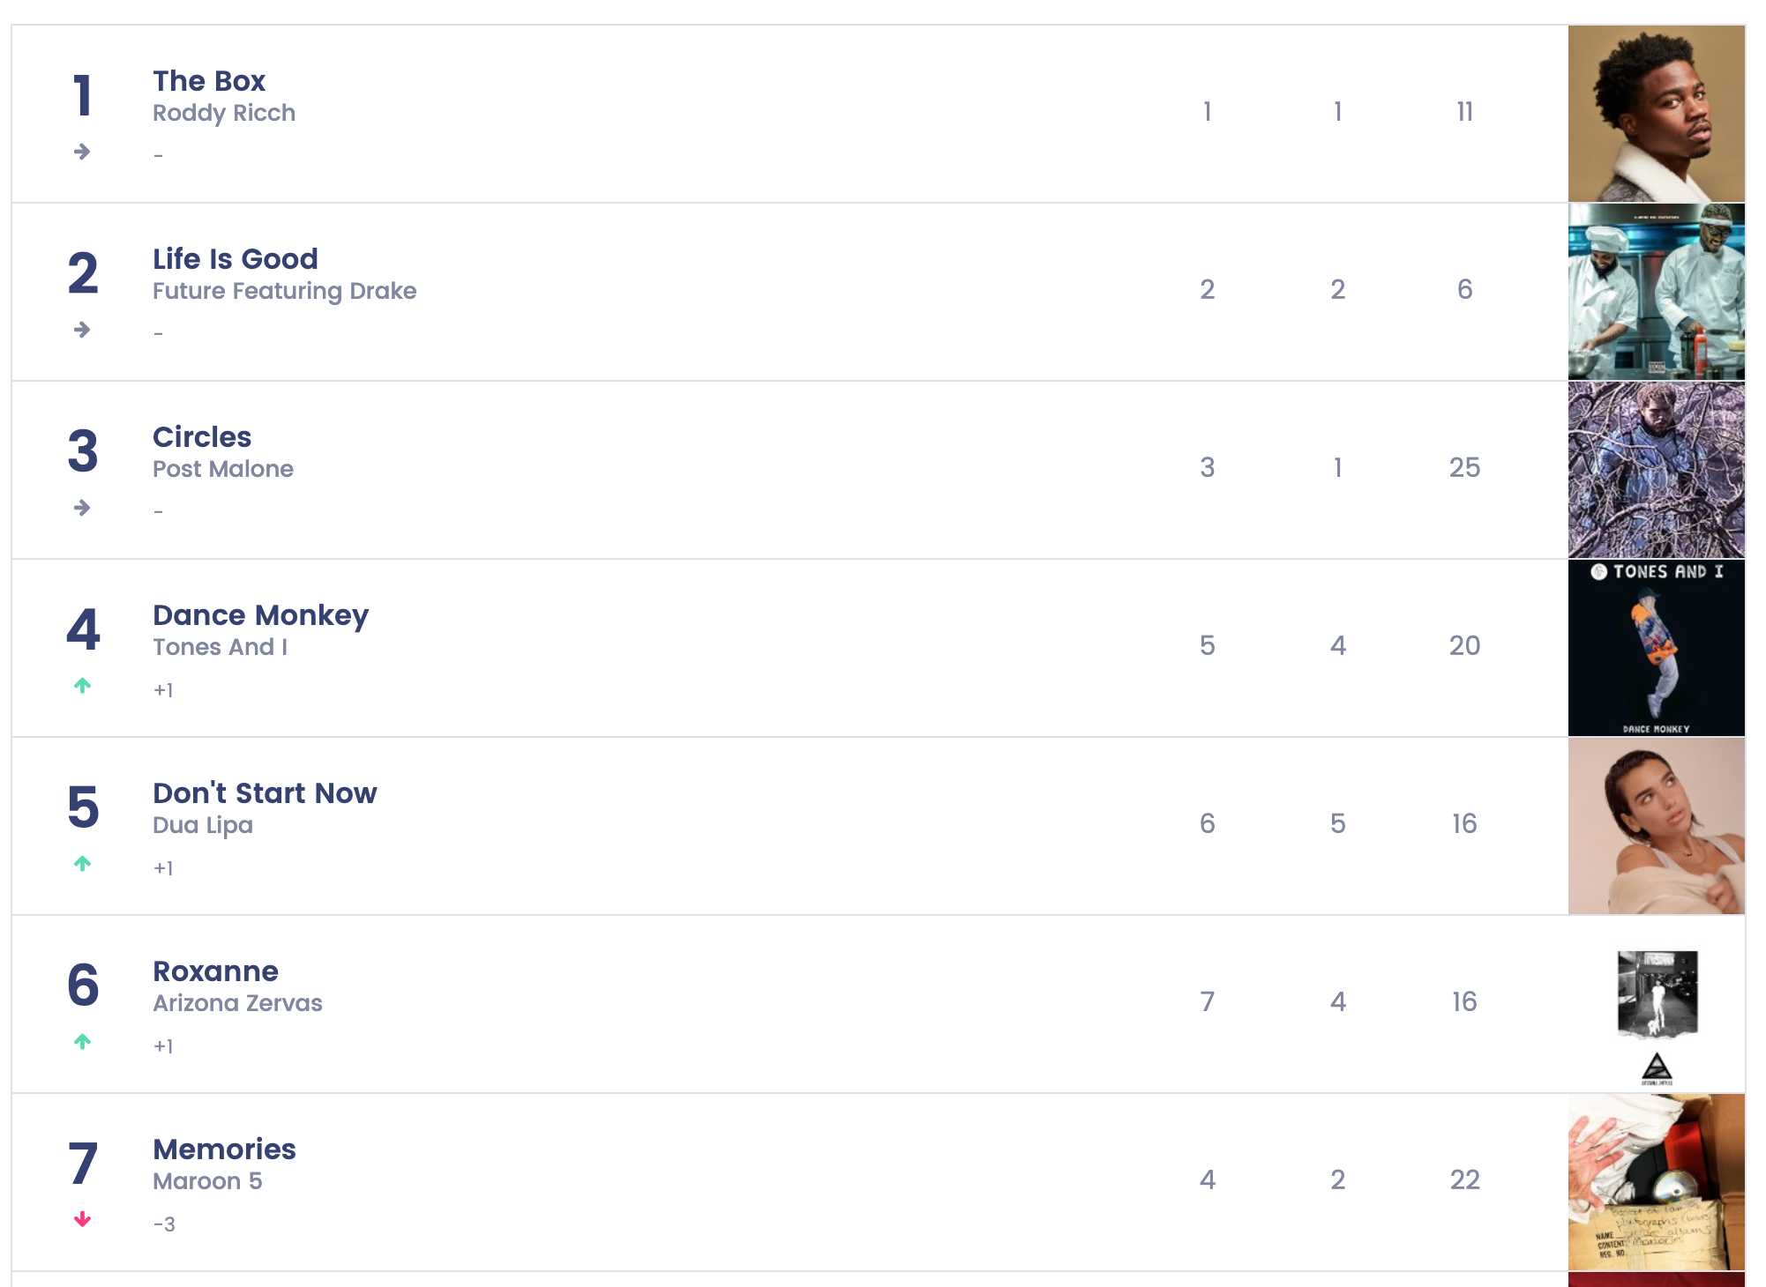
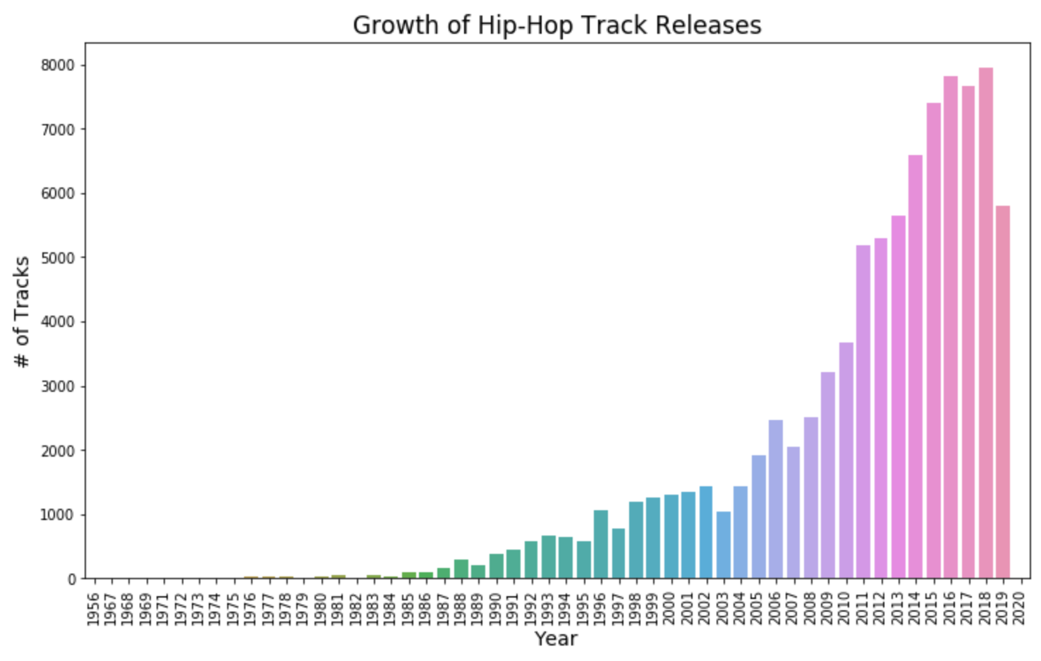
Hip-Hop From the Streets to the Mainstream
America’s biggest music genre
More than 25% of all U.S. music consumption
Rise of social media and ease of music production
Notes:
With the turn of 21st century, hip hop has gained huge success in music industry.
Now, more than 25 percent of all music consumption in US is hip-hop and rise of social medial and ease of music production have made rap music ever more accessible than before.

Slide 3
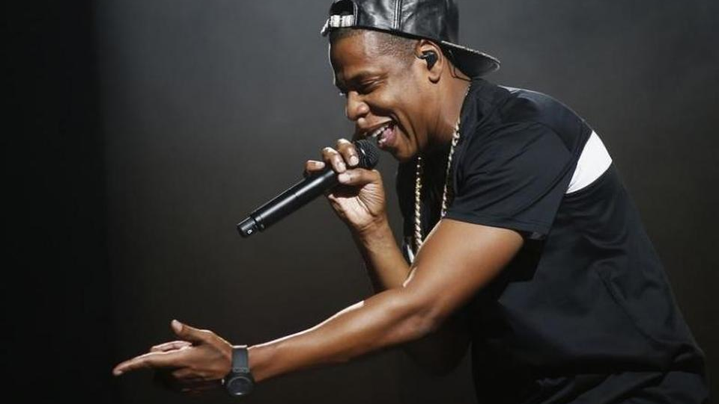
How did rap music evolve over time?
Used NLP to understand if rap music changed over time
Raw Data
Pre-Processing
Data cleaning
Tokenization
Topic Modeling
NMF
EDA
Topic Distribution
Timeseries
~200K Song lyrics from 1950 to 2020
Notes:
With such a rapid growth in hip-hop, how did rap music evolve over time? This is the question I wanted answer using NLP techniques.
To do so, ..

Slide 4

Pre-processing
Verse level documents: removed intro, hooks from the song lyrics
Removed numbers, punctuations, capital letters
Stemming
TF-IDF
Token pattern more than 3 characters
max_df 20%, min_df 1%

Slide 5
Topic Modeling (NMF)
Topic | Key Words
Money | money, cash, count, spend, stack, hundred, bank, pocket, dollar
Hood Life | streets, hood, enough, hustle, friend, broke, night, feeling, everything
Drug / Gangster | smoke, high, shoot, shot, gang, chain, cop, young, pills, tripping
Sex | pussy, dick, fuckin, suck, talkin, lick, head, motherfuck, ass, bust, stick, kiss
Love / Affection | baby, crazy, lady, body, night, tonight, show, kiss, shawty, please
Rap Skills / Music | beat, drop, flow, shot, check, block, rhym, hand, spit, stop, rock, watch, style
Emotion / Hardship | feel, pain, deal, high, inside, hurt, heart, away, feeling, nothing, alone, nobody
Club / Hook-up | club, girl, world, party, friend, night, pretty, body, tonight, drink, shawty

Slide 6
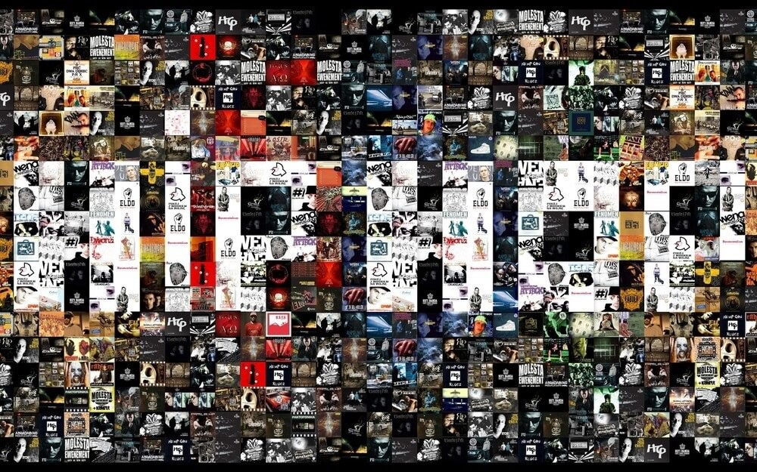
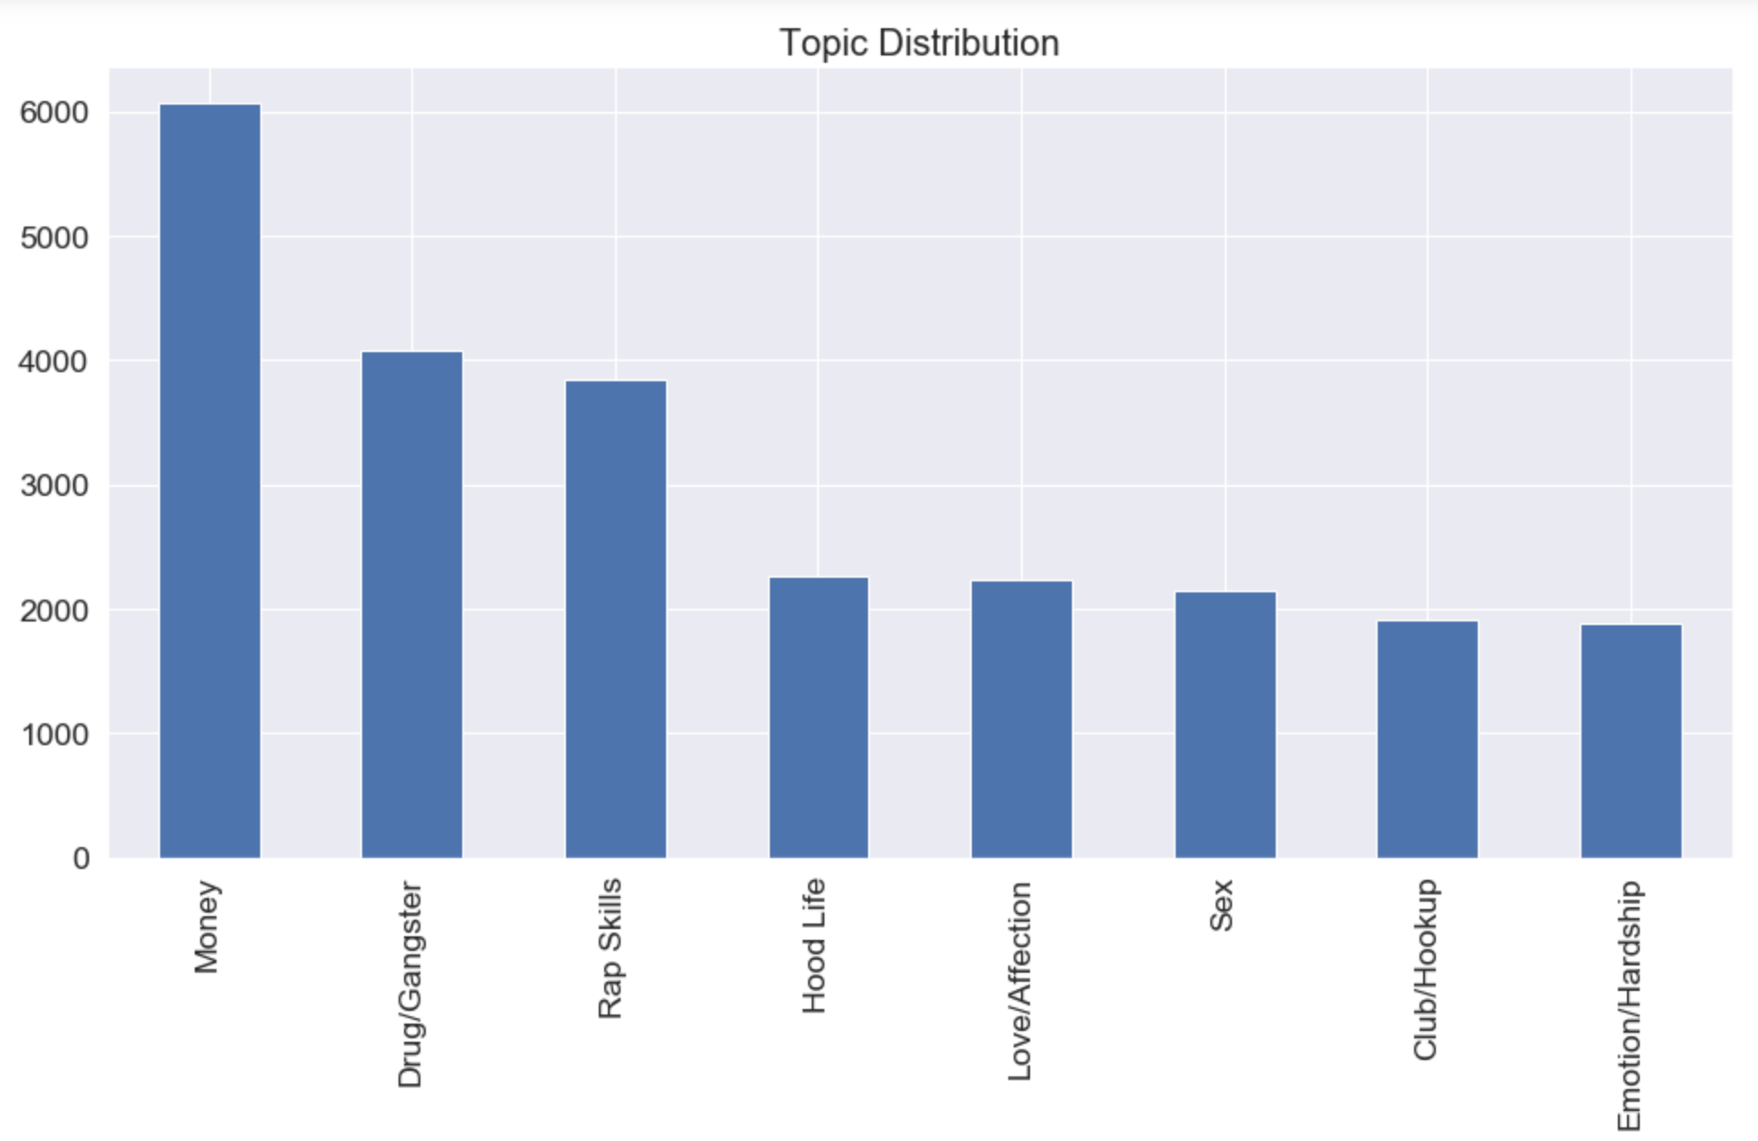
Topic Distribution
Money, Drug, Rap Skills are most talked about throughout

Slide 7
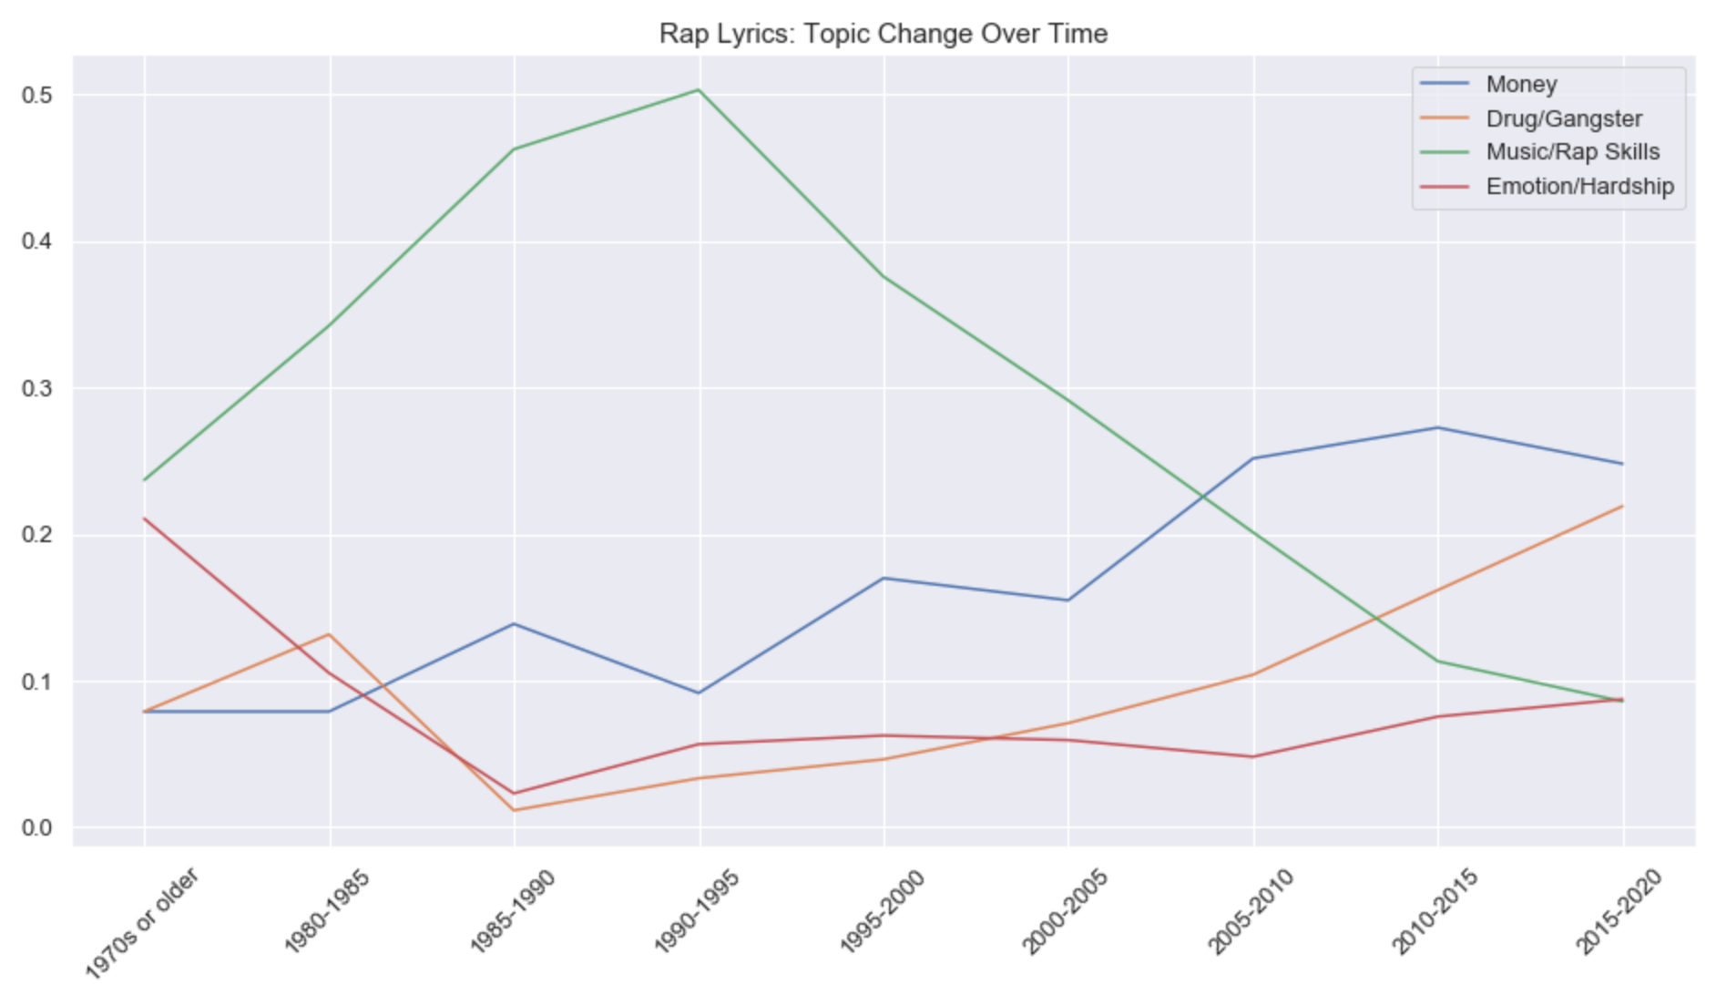
Rap Lyrics Changes Over Time
Notes:
Two key period where the topic trend changed.
1990. Rap music was just a small part of hip hop culture of DJ, Break Dance and MCs. The biggest themes wrere Music, Beats, rap skills as MC.
Huge upward trend of this green line.

Slide 8
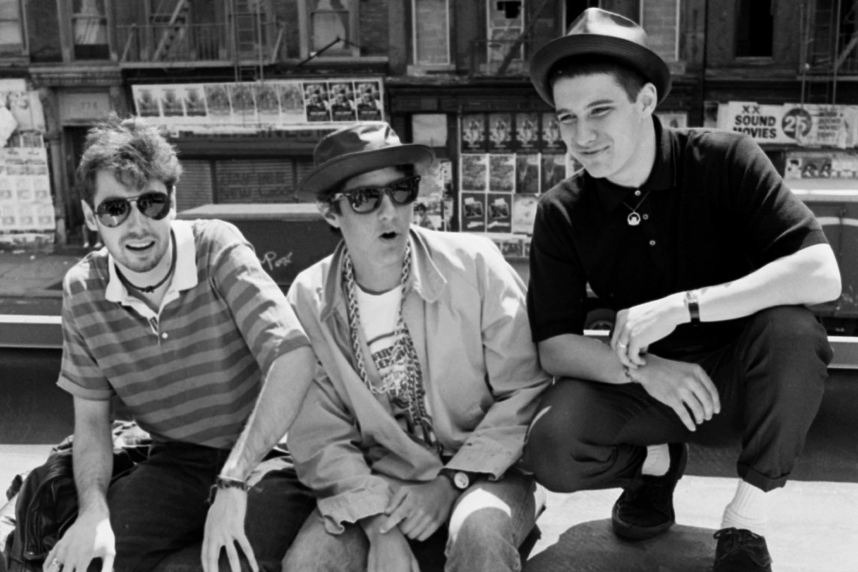
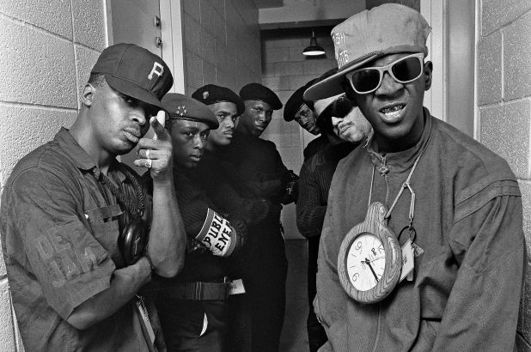
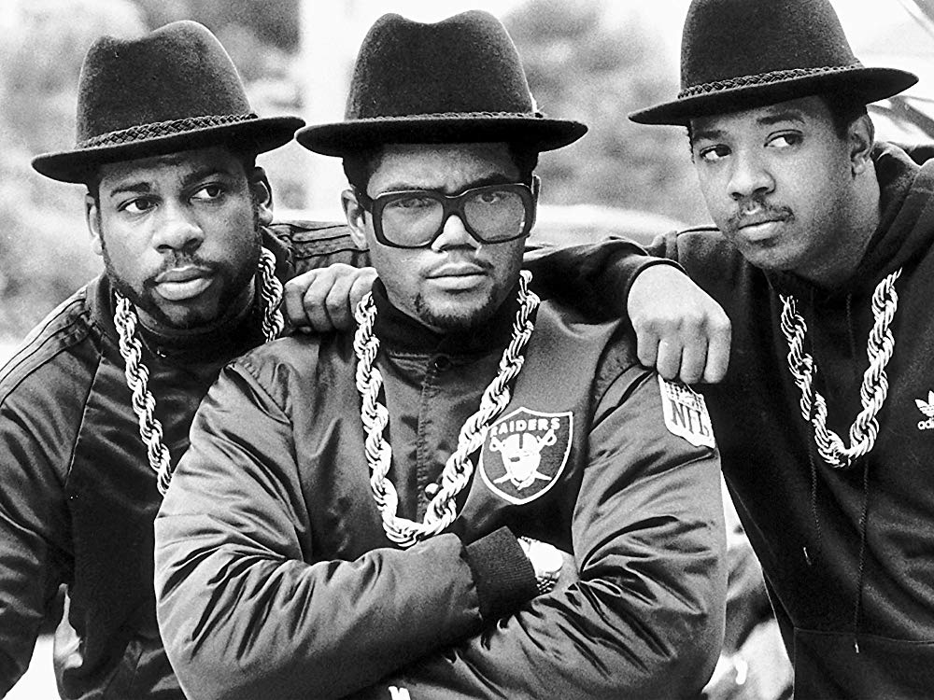
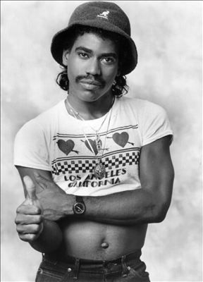
Rap Lyrics Changes Over Time
Notes:
In the 90’s Violence became a huge topics in rap music . This is when gangster rap emerged and a lot of curse words started to appear.

Slide 9
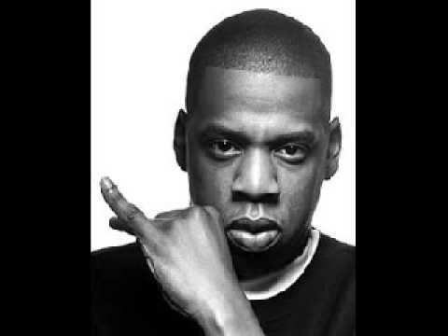
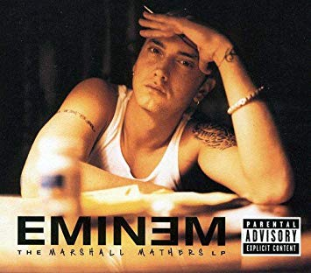
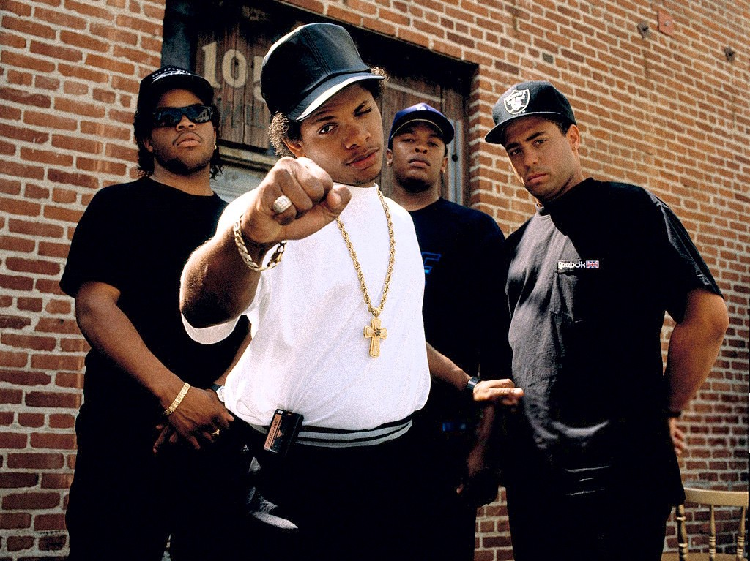
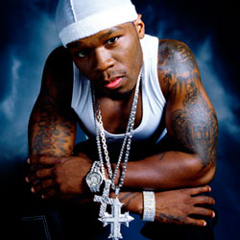
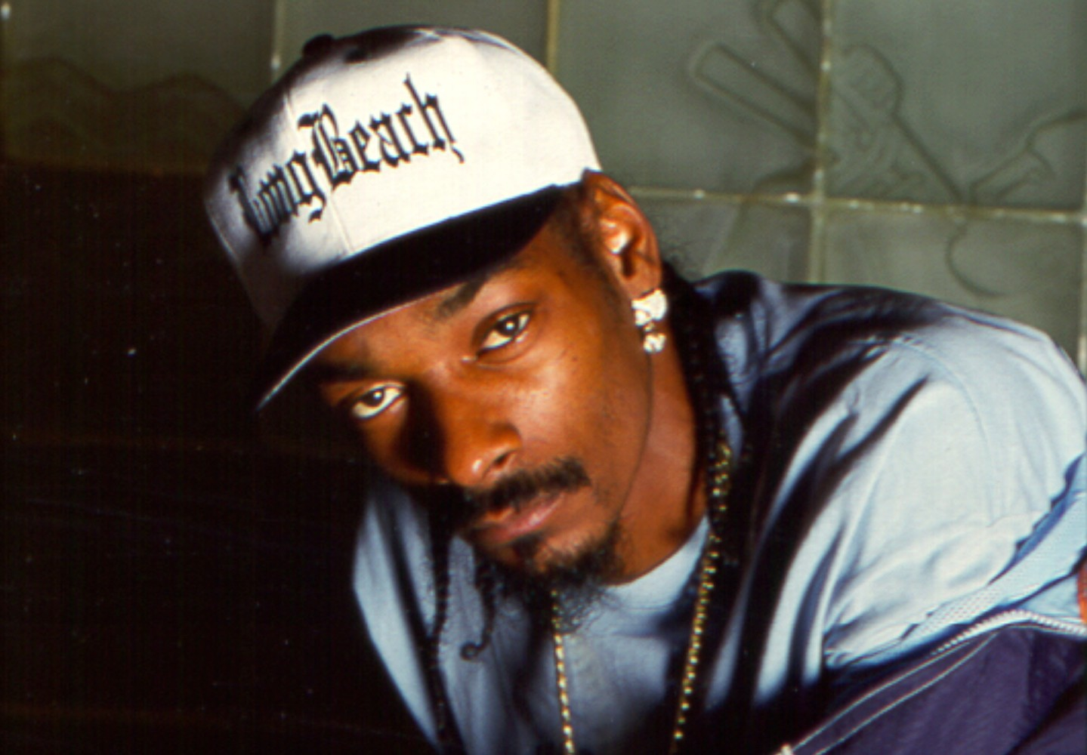
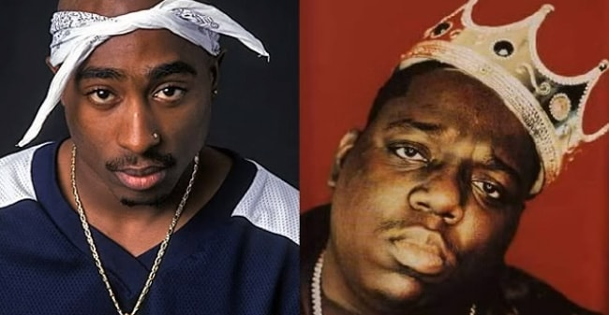
Rap Lyrics Changes Over Time
Notes:
Money Rich become ever more popular topic surpassing this green line.
Drug/Gangster became #2 shortly after.

Slide 10
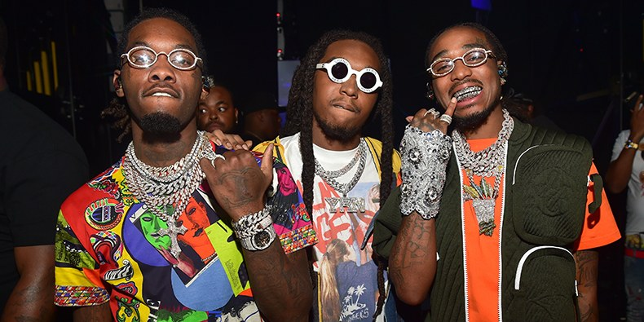
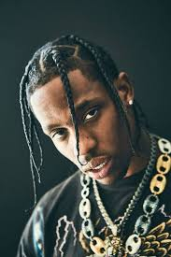
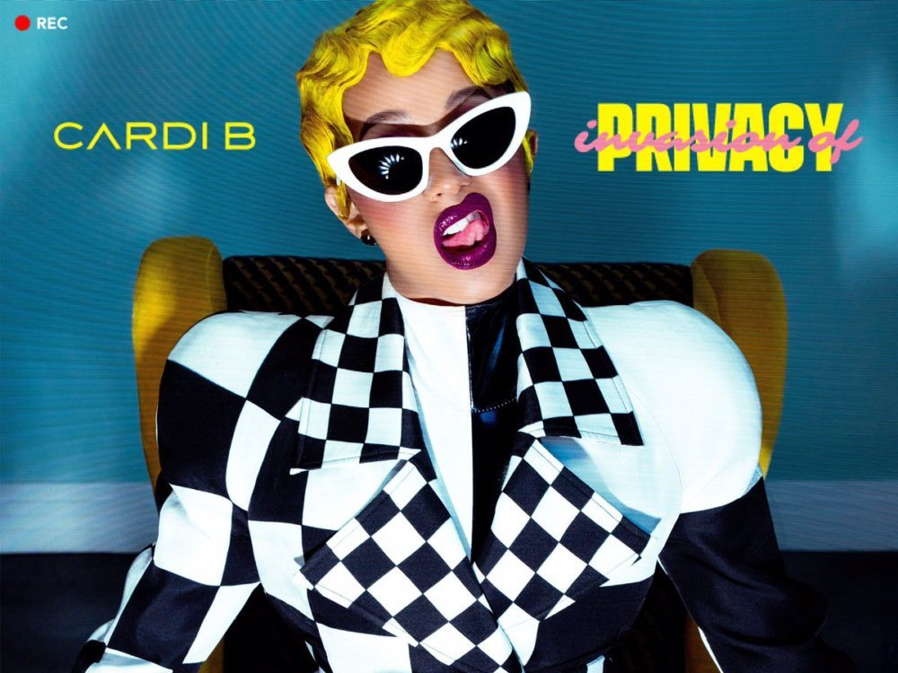
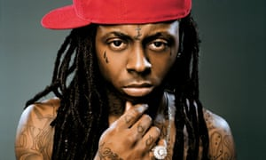
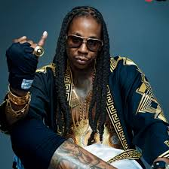
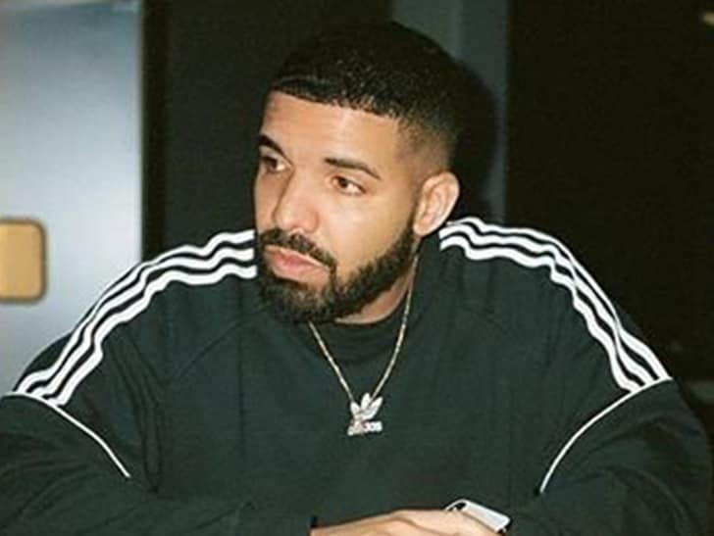
Rap Lyrics Changes Over Time
Notes:
Huge Financial success

Slide 11
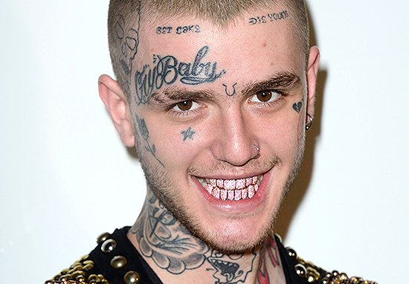

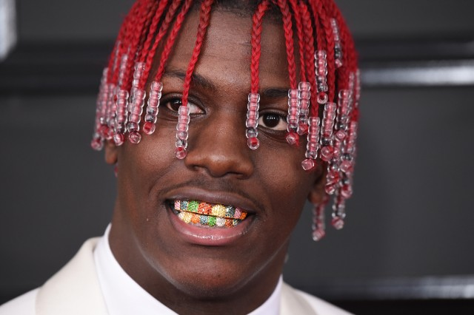
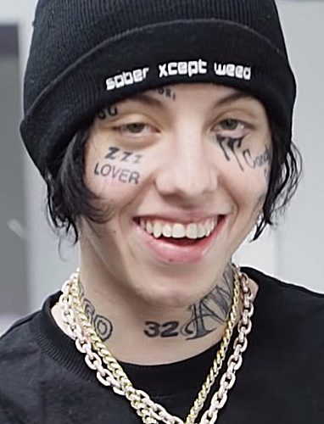
Rap Lyrics Changes Over Time
Notes:
For a while hip-hop wasn’t just about the music. It was about the collectivism. It brought people from different neighborhoods together and allowed them to celebrate and have something in common.

Slide 12
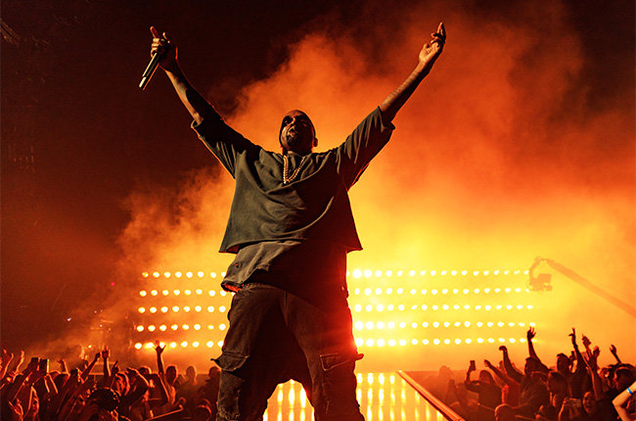
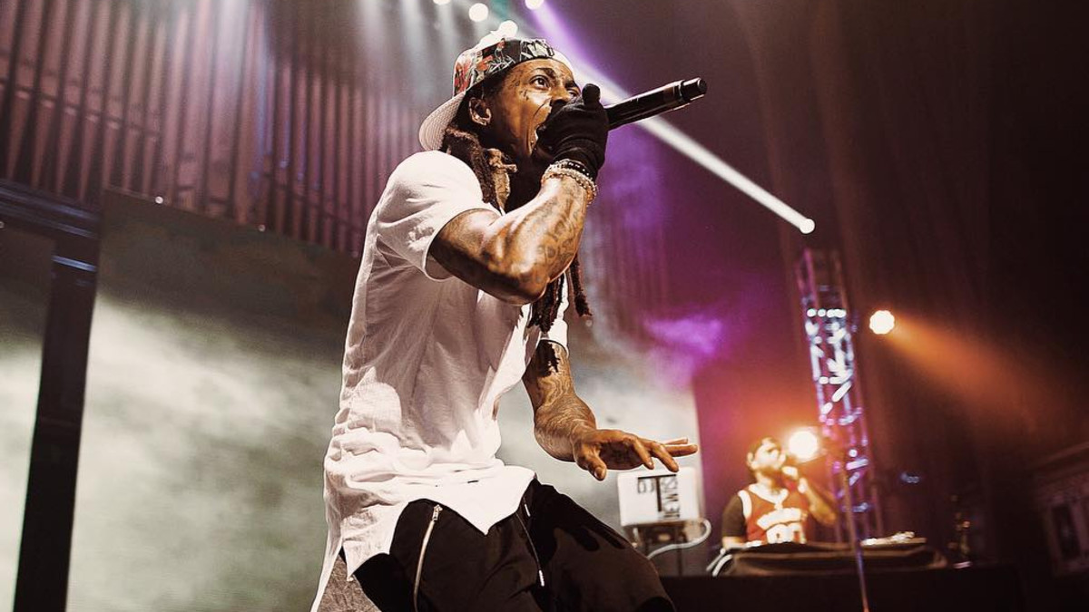
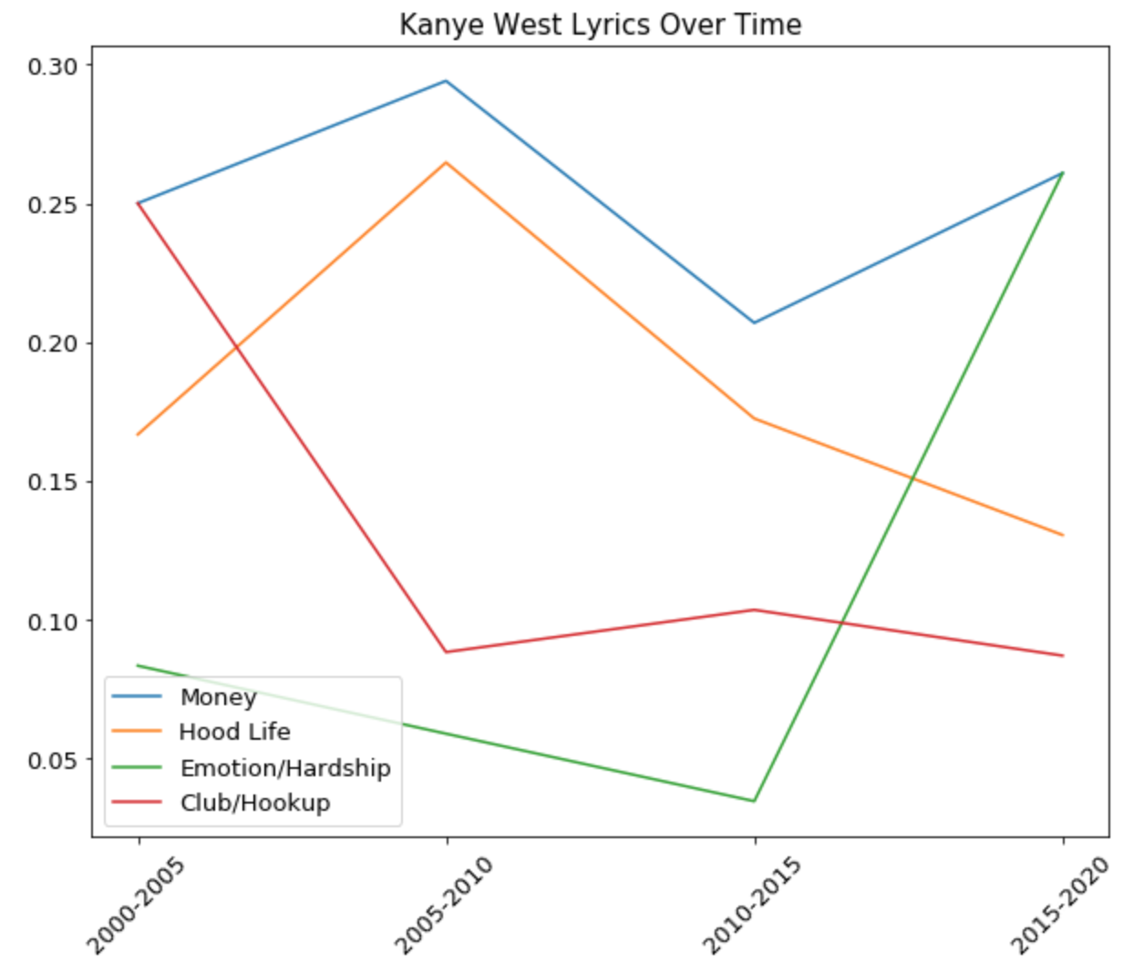
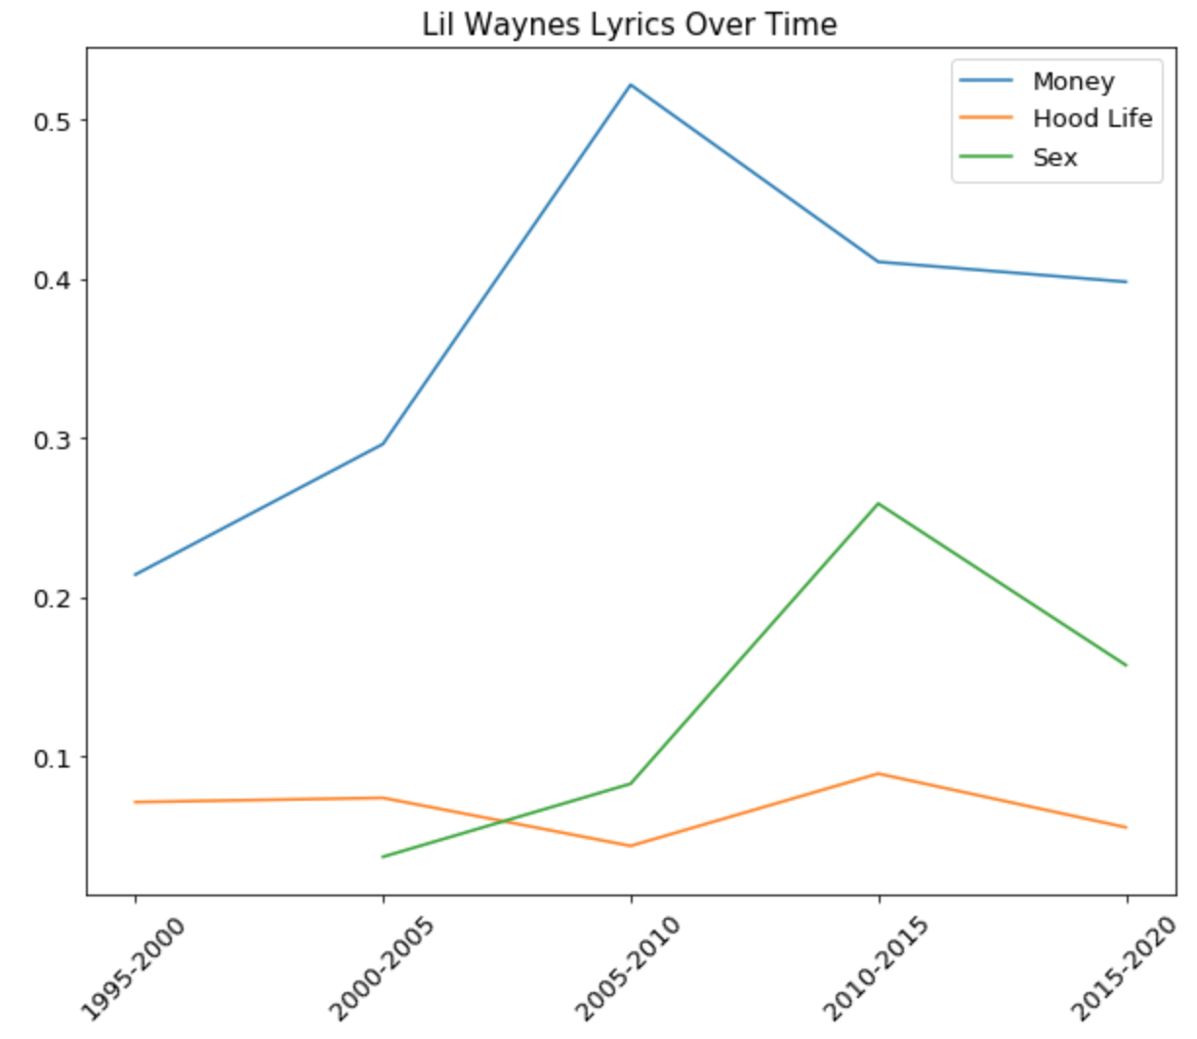
Kanye West vs. Lil Wayne
Kanye speaks more about his emotion and hardship in recent years
Money and Rich was Lil Wayne’s theme through out
Notes:
In the modern rap history, I consider Kanye West and Lil Wayne the most influential artists.
Started to become mental making wild statements and finally admitted he is suffering from bipolar syndrom.

Slide 13
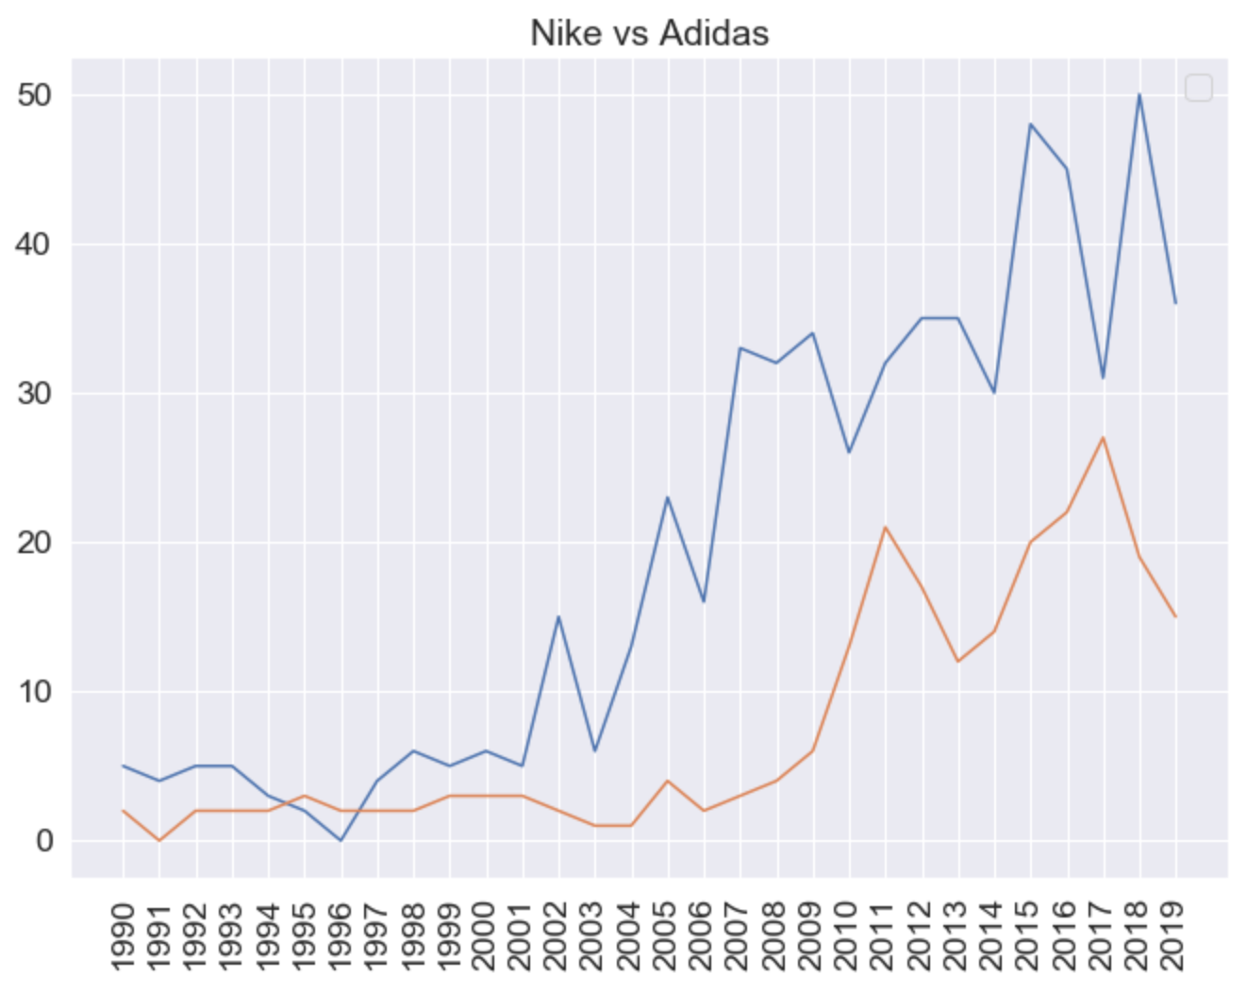
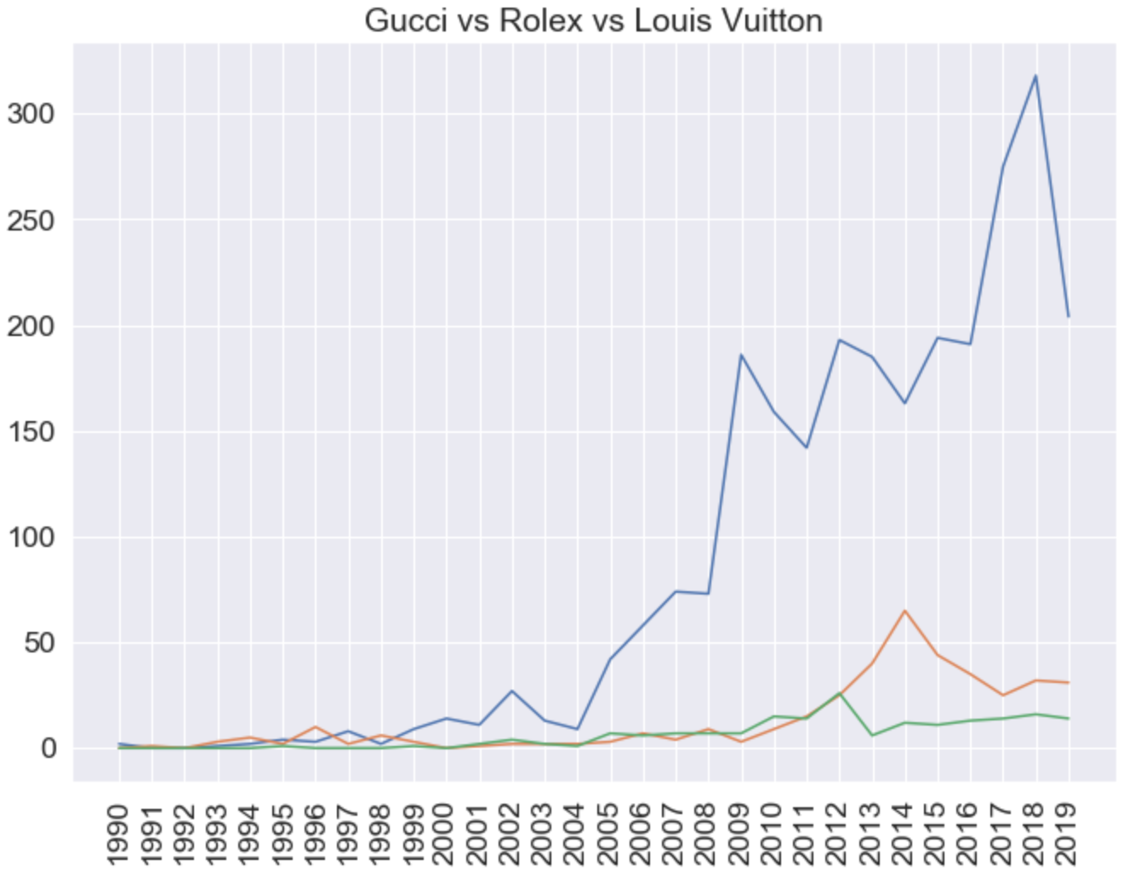
More EDA: Fashion Brand in Rap Lyrics

Slide 14
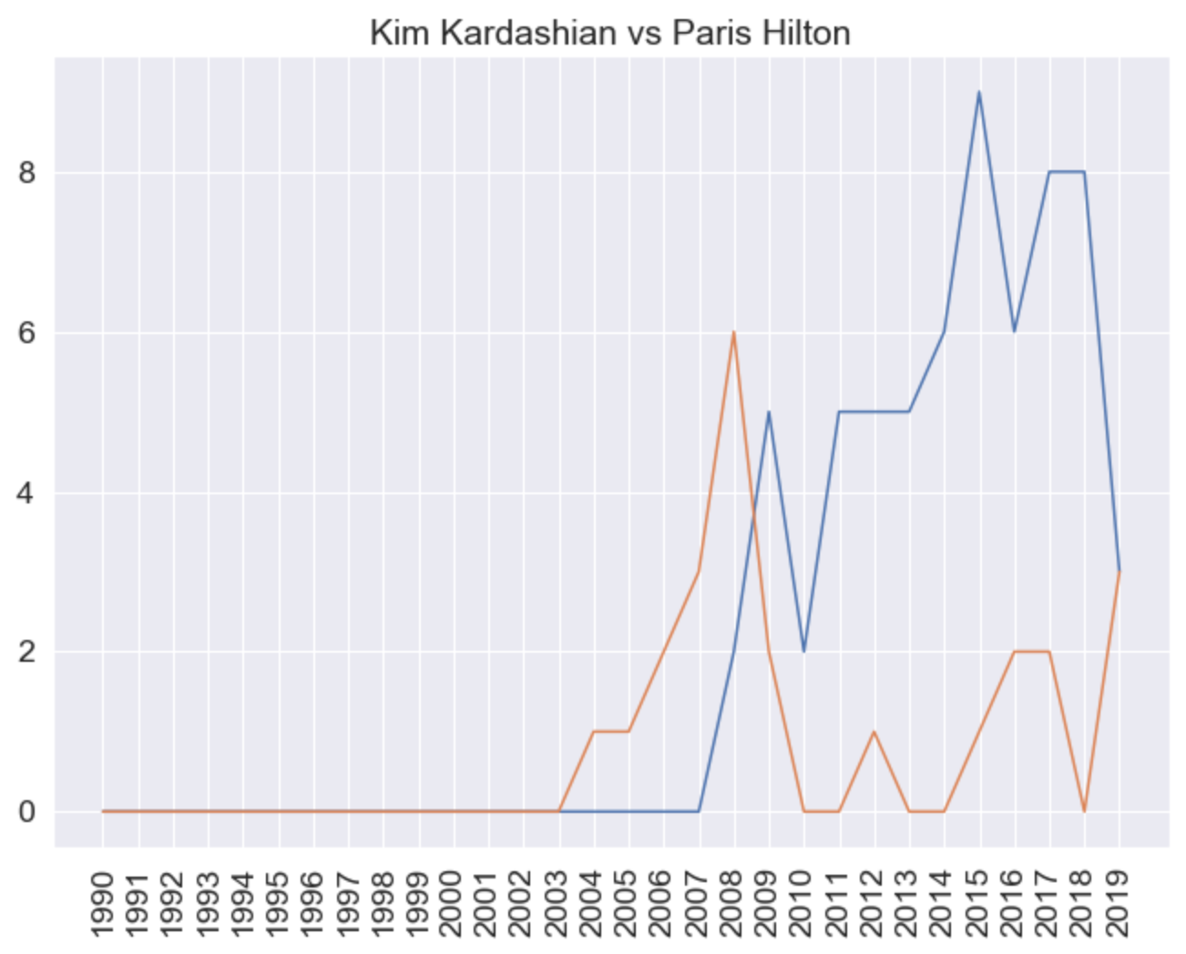
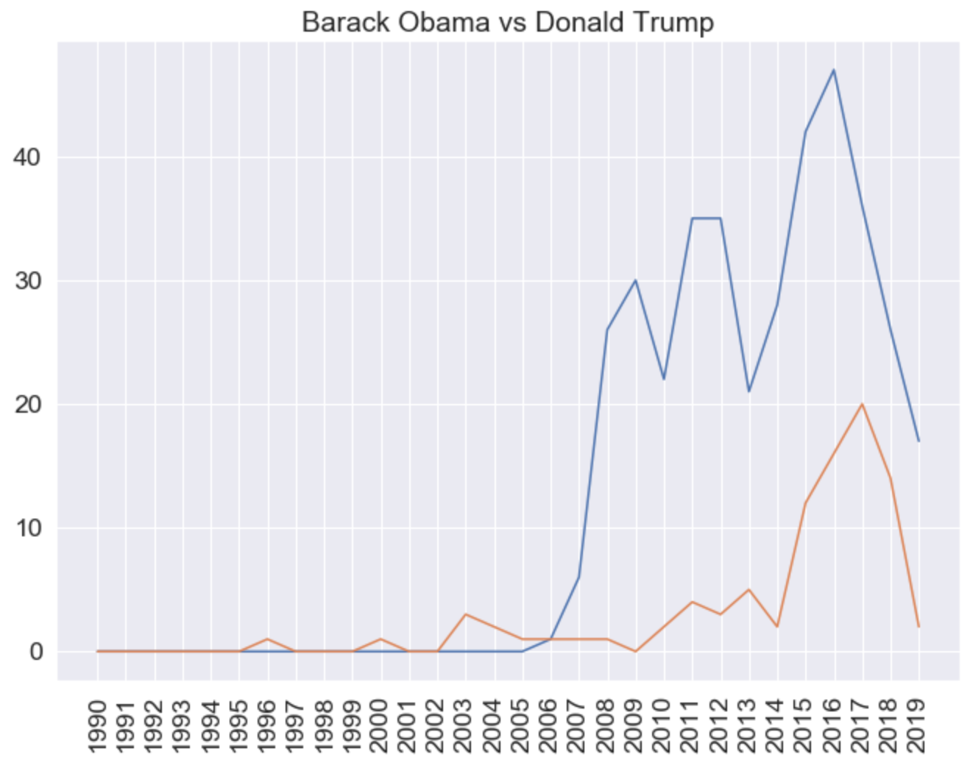
More EDA: People in Rap Lyrics

Slide 15
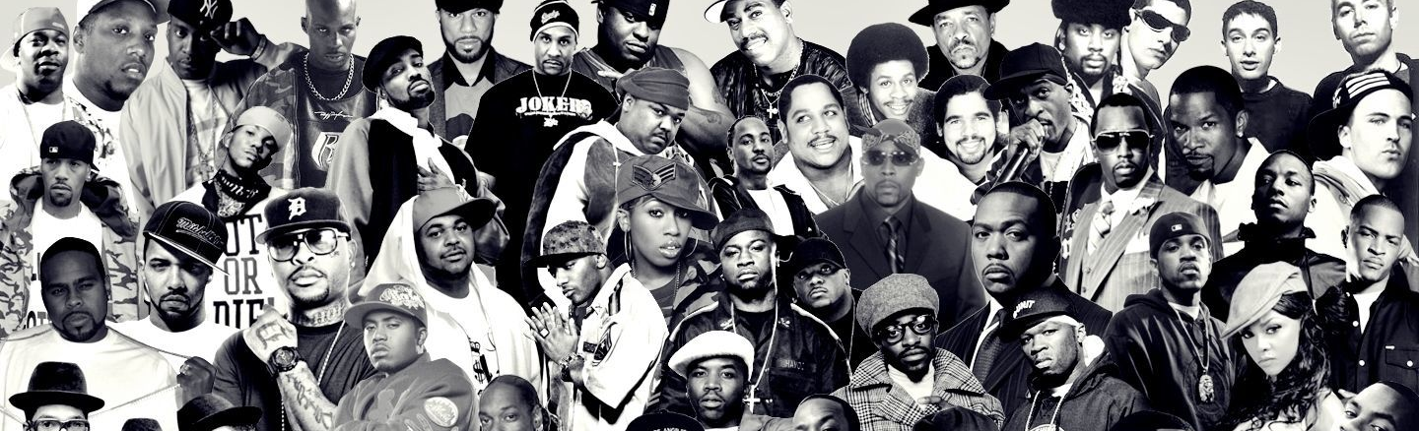
Future Work
Develop recommendation system
Deeper analysis on certain topics (e.g., drug abuse, politics, etc.)
Conduct sentiment analysis

Slide 16
THANK YOU!

